Slide 1
HOTEL AGGREGATOR ANALYSIS
USING POWER BI
BY GANESH.

Slide 2
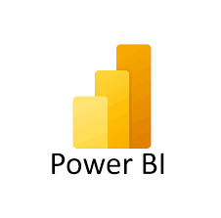
WHAT IS POWER BI?
Power BI is a business analytics tool developed by Microsoft. It allows users to create interactive visualizations and business intelligence reports that can be shared across an organization. With Power BI, users can connect to various data sources, such as databases, spreadsheets, or online services, to gather data and create meaningful insights.
The key features of Power BI include data visualization, where users can create compelling charts, graphs, and dashboards to represent their data; data modeling.

Slide 3
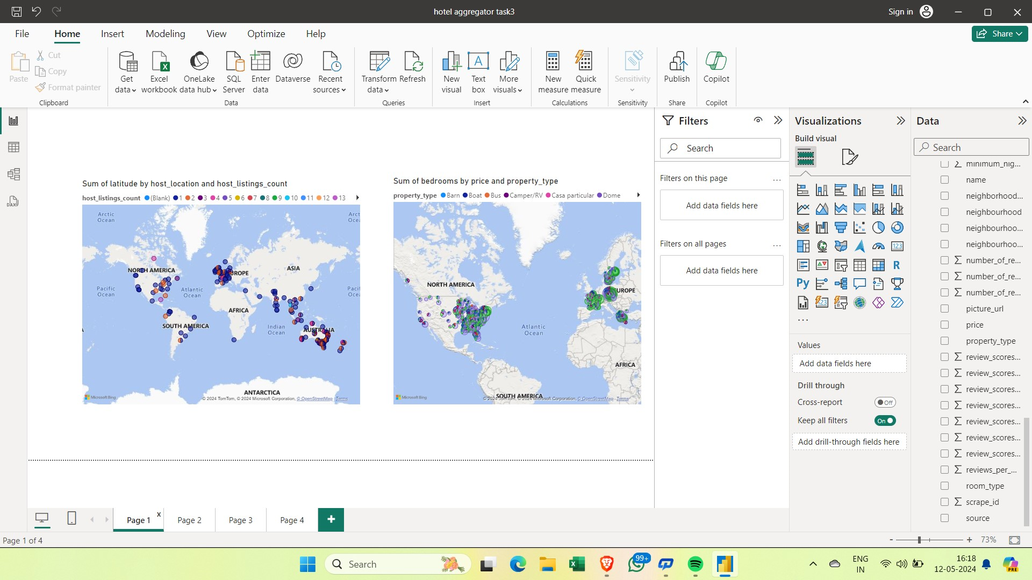
GEOGRAPHICAL INSIGHTS AND PRICING ANALYSIS.

Slide 4
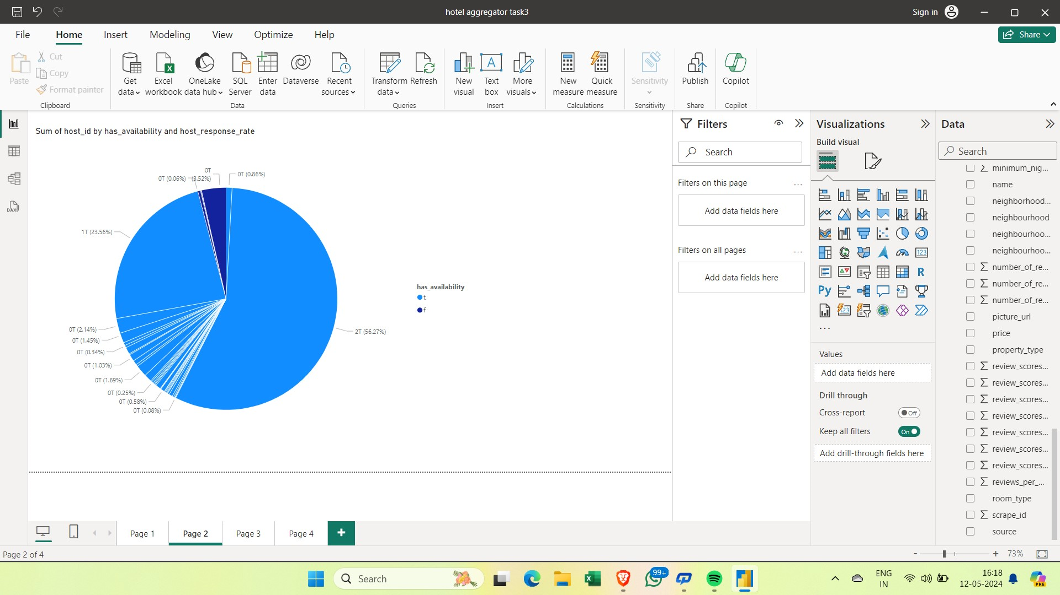
HOST PERFORMANCE.

Slide 5
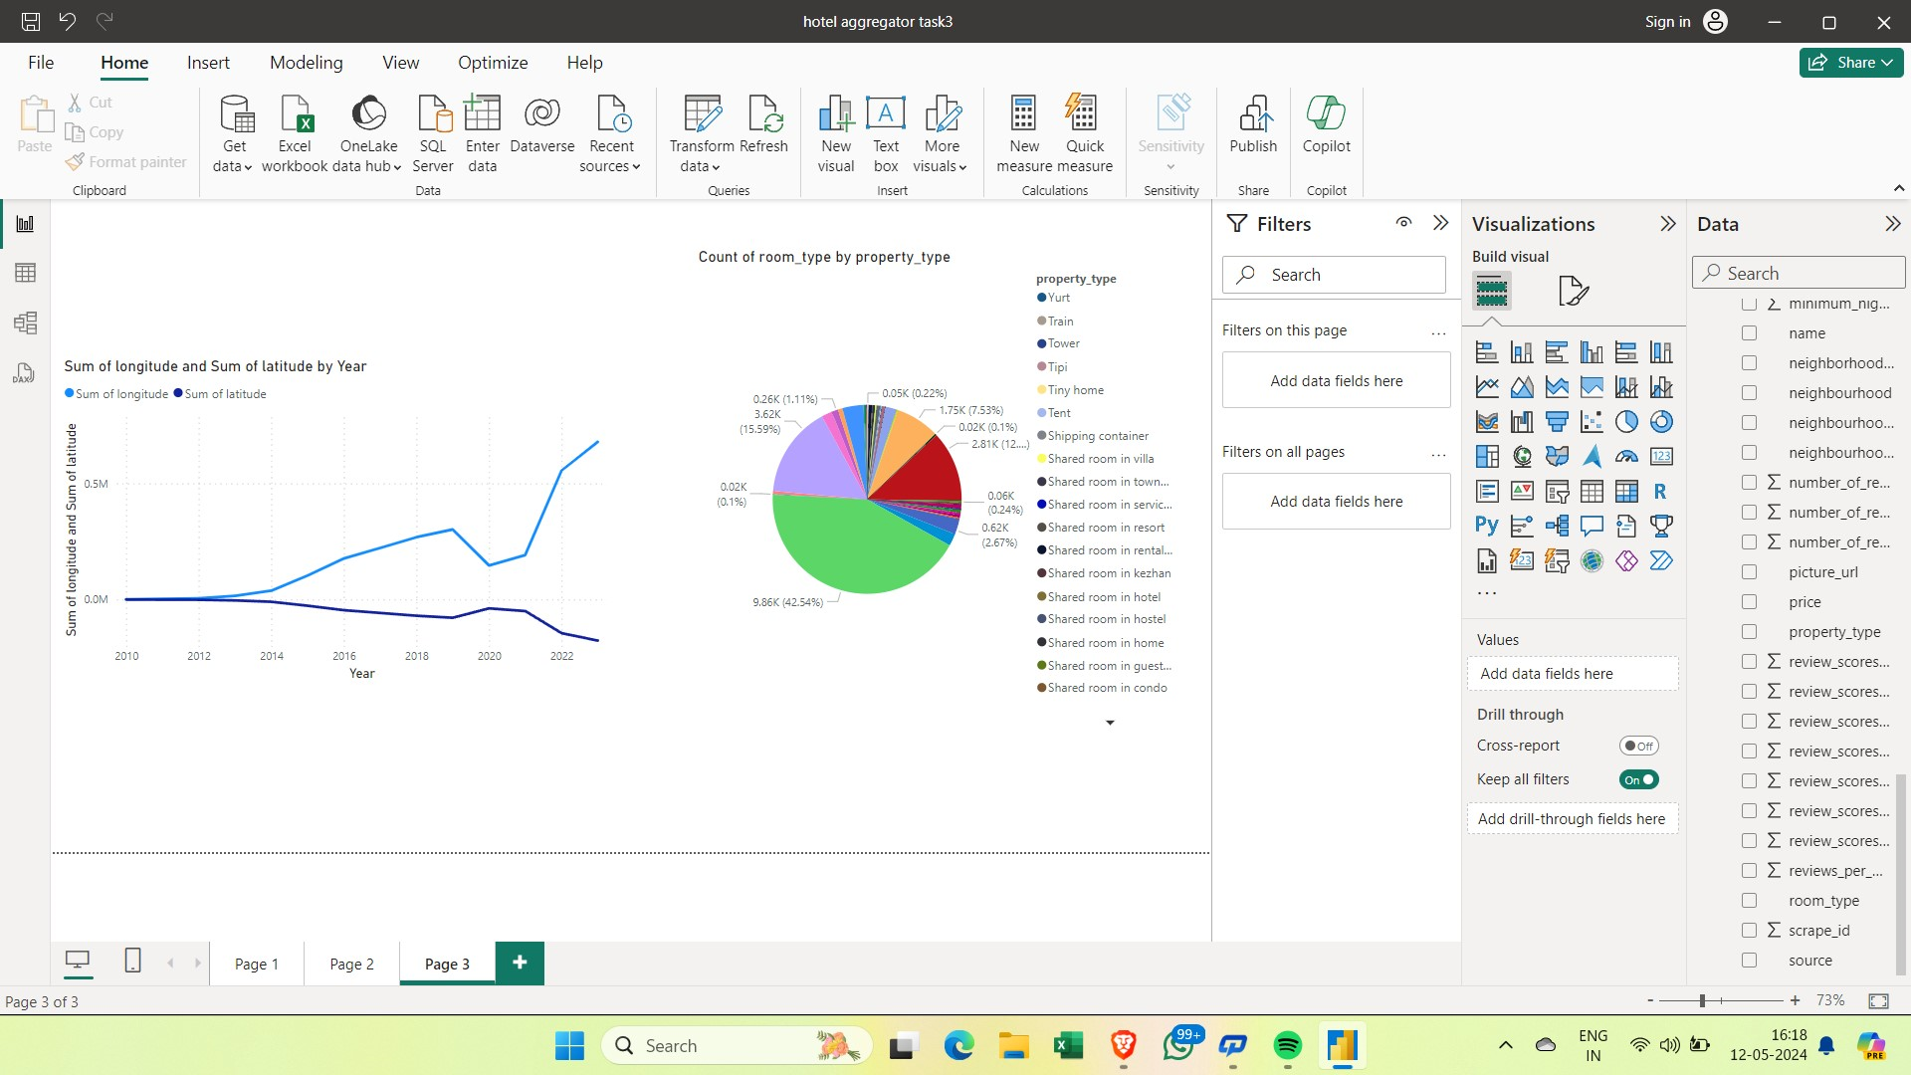
REVIEW SCORES,PROPRTY TYPE AND ROOM TYPES.

Slide 6


